Slide 1


Marco Boccenti
04/19/2022

Slide 2
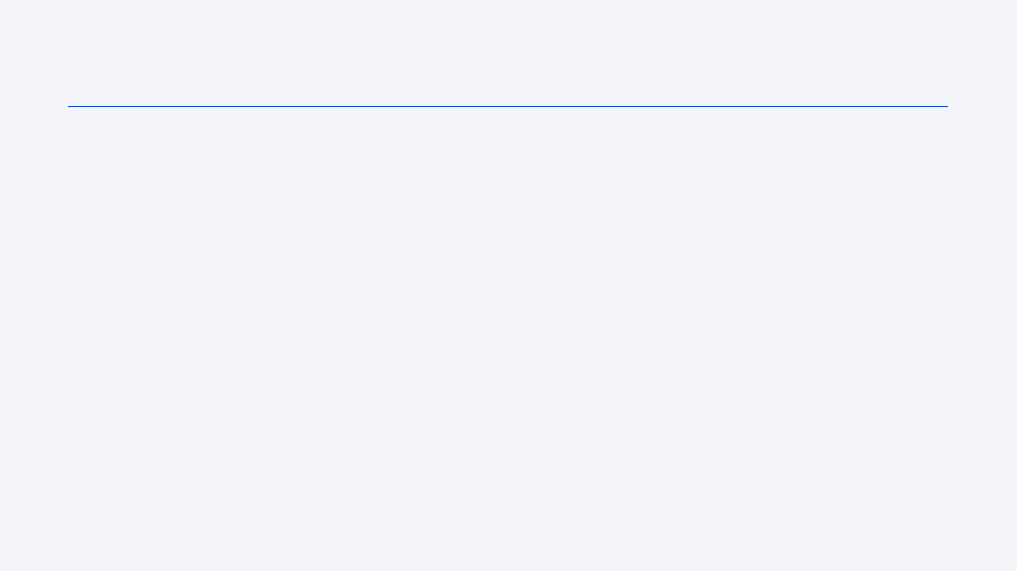
Outline
Executive Summary
Introduction
Methodology
Results
Conclusion
Appendix

Slide 3
Executive Summary
Summary of methodologies
Data collected through SpaceX API and web-scraping
Data prepared and transformed into a useable subset
Model selected trough comparison
Summary of all results
EDA identified the best features to predict successful landings;
Machine Learning model predicted if the Falcon 9 first stage will land successfully.

Slide 4
Introduction
Project background and context
SpaceX advertises Falcon 9 rocket launches on its website, with a cost of 62 million dollars; other providers cost upward of 165 million dollars each, much of the savings is because SpaceX can reuse the first stage.
Problems you want to find answers
We need a model able to predict the success of a landing to calculate the cost of a launch.
We also need to identify the best site launch.

Slide 5

Section 1

Slide 6
Methodology
Executive Summary
Data collection methodology:
Through SpaceX API (https://api.spacexdata.com/v4/rockets/)
Web-scraping of Falcon 9 Wikipedia page https://en.wikipedia.org/wiki/List_of_Falcon/_9/_and_Falcon_Heavy_launches
Perform data wrangling
Added a landing outcome label based on outcome data after summarizing and analysing features

Slide 7
Methodology
Executive Summary
Perform exploratory data analysis (EDA) using visualization and SQL
Perform interactive visual analytics using Folium and Plotly Dash
Perform predictive analysis using classification models
Data collected were normalized, divided into training and test data sets, and evaluated by four different classification models. The accuracy of each model was assessed using various combinations of parameters.

Slide 8
Data Collection
We collected data sets from SpaceX API and, using web scraping techniques, the Falcon9 Wikipedia page.

Slide 9
Data Collection – SpaceX API
We first requested rocket launch data from SpaceX API.
Then we used the API again to get information about the launches using the IDs given for each launch. Specifically, we used columns rocket, payloads, launchpad, and cores.
From the rocket we learned the booster's name
From the payload we learned the mass of the payload and the orbit that it is going to
From the launchpad we learned the name of the launch site being used, its longitude, and latitude.
From cores, we learned the outcome and the type of the landing, the number of flights with that core, whether grid fins were used, whether the core was reused, and other pieces of information.
GitHub URL of the completed SpaceX API calls notebook

Slide 10
Data Collection - Scraping
We performed web scraping to collect Falcon 9 historical launch records from a Wikipedia page titled List of Falcon 9 and Falcon Heavy launches https://en.wikipedia.org/wiki/List_of_Falcon\_9\_and_Falcon_Heavy_launches
During this process we scrapped Falcon 9 launch records with BeautifulSoup:
Extracting a Falcon 9 launch records HTML table from Wikipedia
Parsing the table and convert it into a Pandas data frame
GitHub URL of the completed web scraping notebook

Slide 11
Data Wrangling
We performed some Exploratory Data Analysis (EDA) to find patterns in the data and determine what would be the label for training supervised models.
The main contribution was converting landing outcomes into training labels with ‘1’ meaning the booster successfully landed and ‘0’ representing the landing was unsuccessful.
GitHub URL of your completed data wrangling related notebooks

Slide 12
EDA with Data Visualization
We rendered scatter plots and bar plots to visualize the relationship between pair of features:
Payload Mass vs Flight Number
Launch Site vs Flight Number
Launch Site vs Payload Mass
Orbit vs Flight Number
Payload vs Orbit
GitHub URL of your completed EDA with data visualization notebook

Slide 13
EDA with SQL
We used SQL queries to:
Display the names of the unique launch sites in the space mission
Display 5 records where launch sites begin with the string 'CCA’
Display the total payload mass carried by boosters launched by NASA (CRS)
Display average payload mass carried by booster version F9 v1.1
List the date when the first successful landing outcome in ground pad was achieved.
List the names of the boosters which have success in drone ship and have payload mass greater than 4000 but less than 6000
List the total number of successful and failure mission outcomes
List the names of the booster versions which have carried the maximum payload mass.
GitHub URL of your completed EDA with SQL notebook

Slide 14
Build an Interactive Map with Folium
We used markers, circles, lines and marker clusters on Folium Maps to highlight:
The location of launch sites
Points of interest, such as the like NASA Johnson Space Center
Distance between launch sites and geographical features, like a coastline
Cluster of events with close coordinates
GitHub URL of your completed interactive map with Folium map

Slide 15
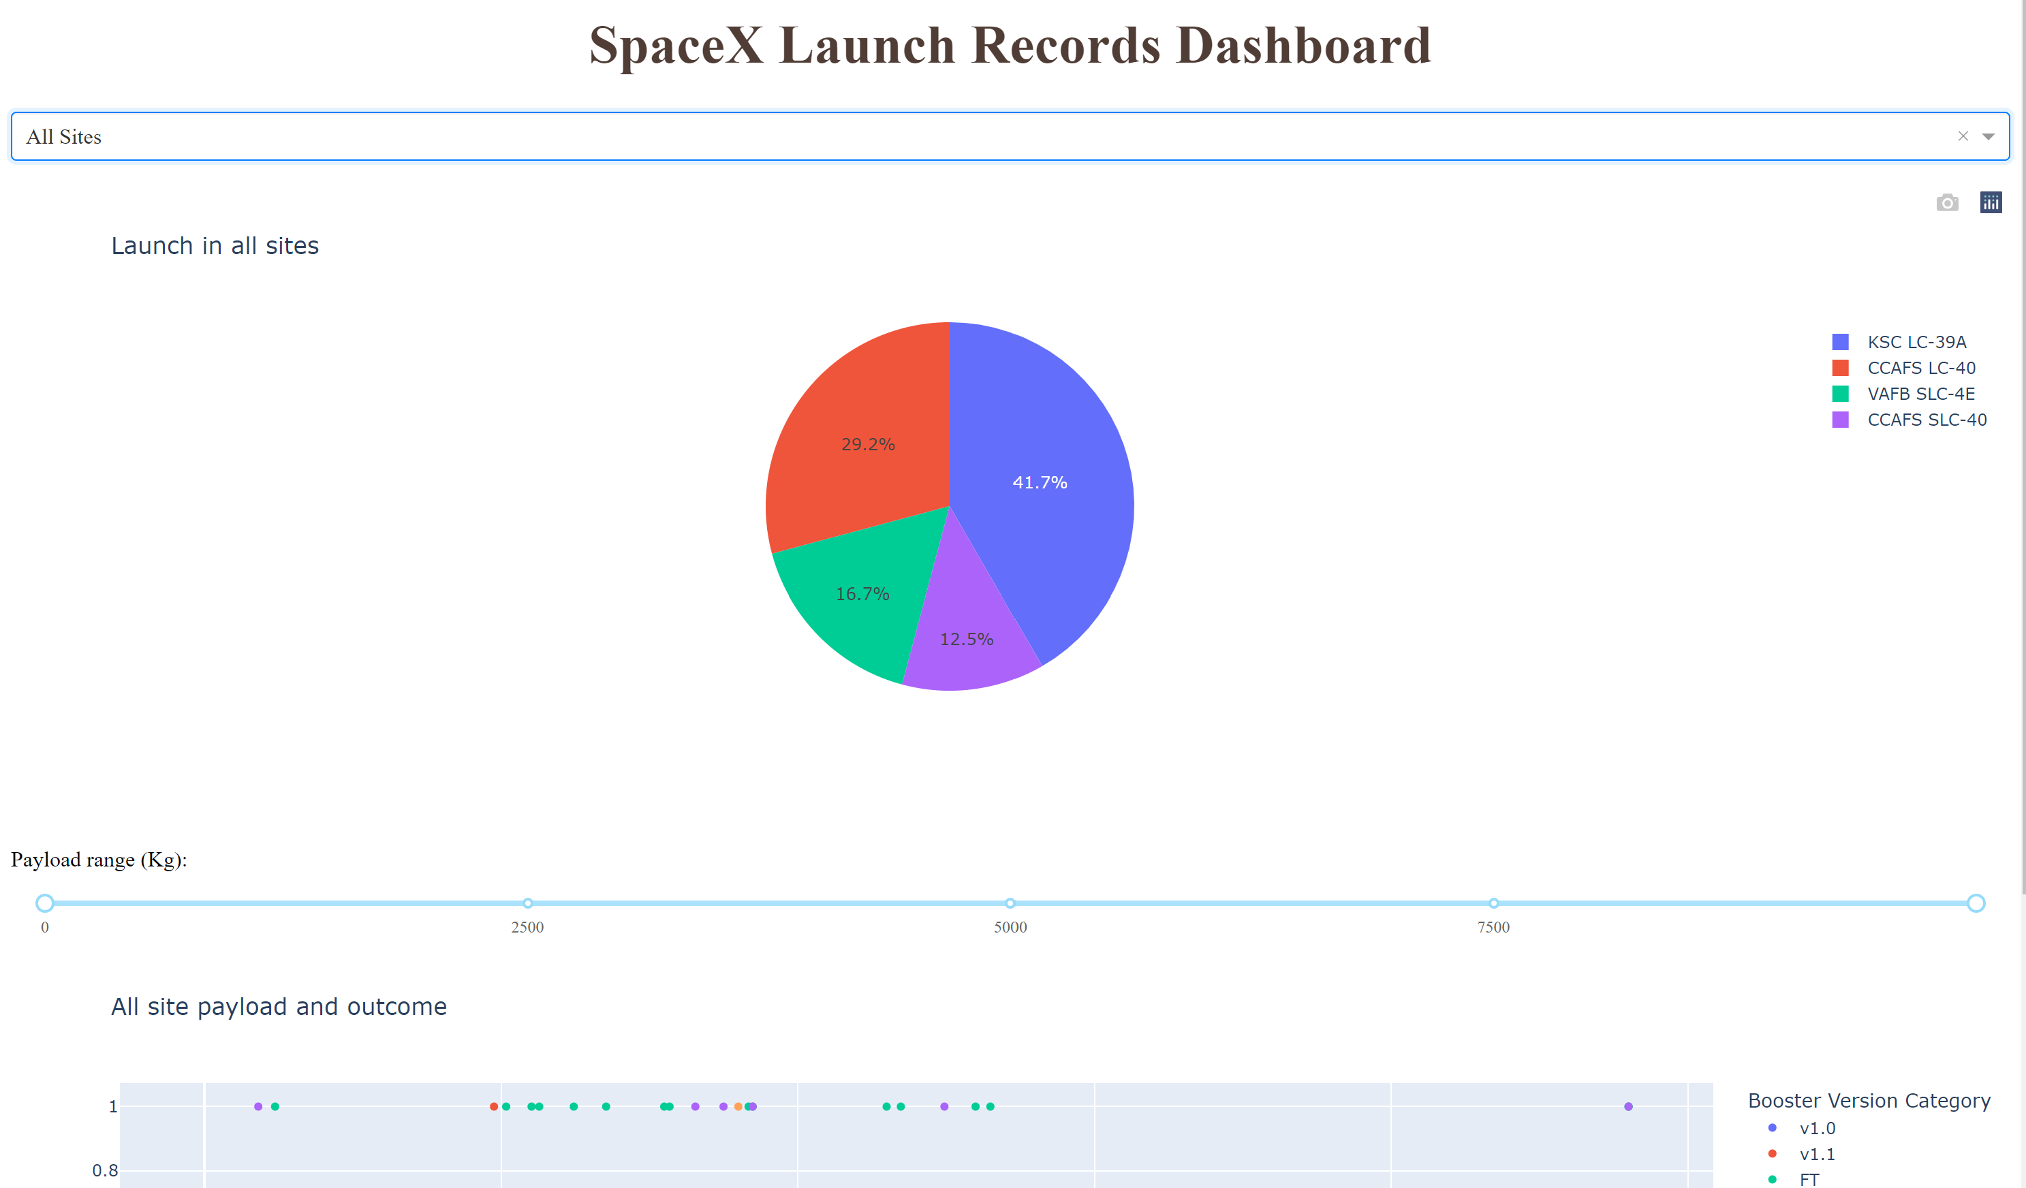
Build a Dashboard with Plotly Dash
The dashboard allowed us to quickly analyze the relationship between payloads and launch sites, helping us to identify the best launch sites by payload mass.
GitHub URL of your completed Plotly Dash lab

Slide 16
Predictive Analysis (Classification)
We compared the performance of four classification models :
Logistic regression,
Support vector machine
Decision tree
K-nearest neighbors
GitHub URL of the completed predictive analysis lab

Slide 17
Results
Exploratory data analysis results:
SpaceX uses four launch sites
The average payload of F9 v1.1 booster is 2,928 kg;
The first successful landing outcome happened in 2015, five year after the first launch;
Falcon 9 booster versions were successful at landing in drone ships having payload above the average;
Two booster versions failed at landing in drone ships in 2015: F9 v1.1 B1012 and F9 v1.1 B1015;
The number of landing outcomes increases year by year.

Slide 18

Section 2

Slide 19
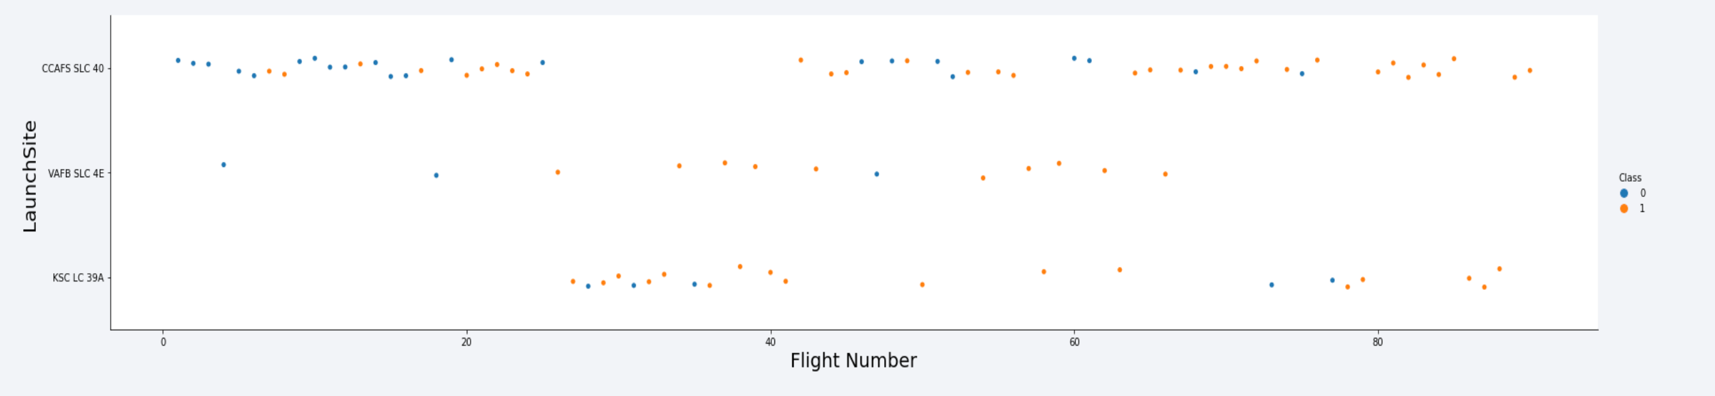
Flight Number vs. Launch Site
According to the plot above, the most successful launch site is CCAF5 SLC 40
In second place VAFB SLC 4E and third place KSC LC 39A;
Also, the overall success rate is improving over time.

Slide 20
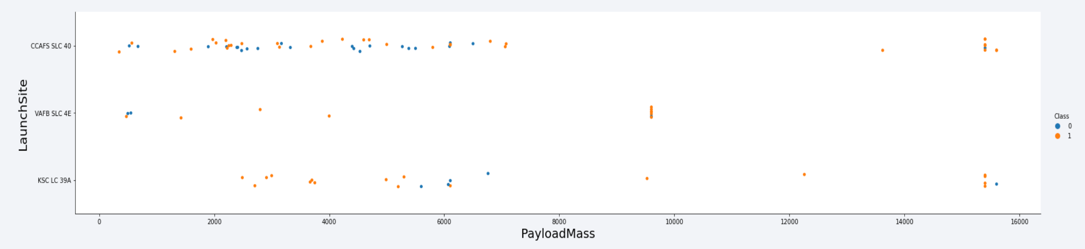
Payload vs. Launch Site
Higher payloads (over 12,000kg) have a better success rate at CCAFS SLC 40 and KSC LC 39A launch sites

Slide 21
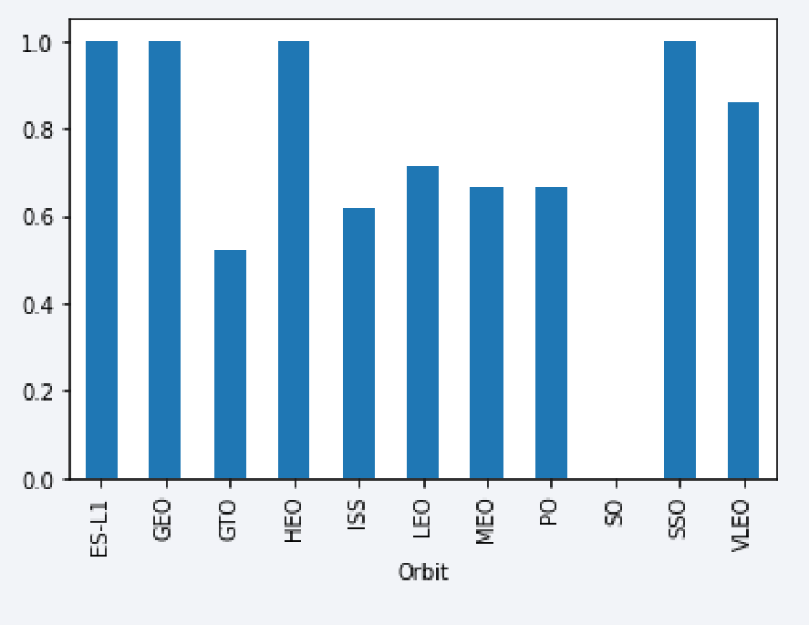
Success Rate vs. Orbit Type
The following orbits have the highest success rates:
ES-L1
GEO
HEO
SSO

Slide 22
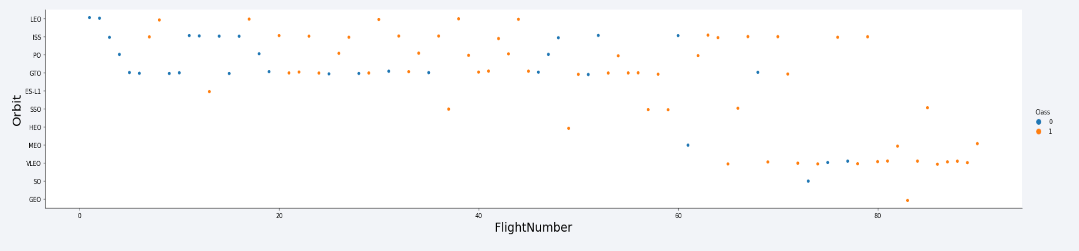
Flight Number vs. Orbit Type

Slide 23
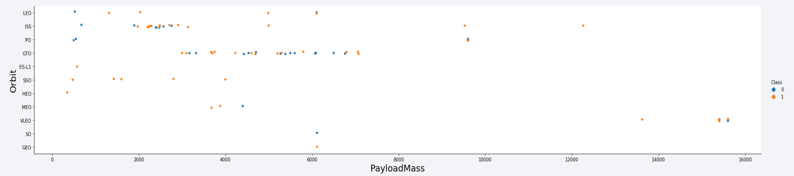
Payload vs. Orbit Type

Slide 24
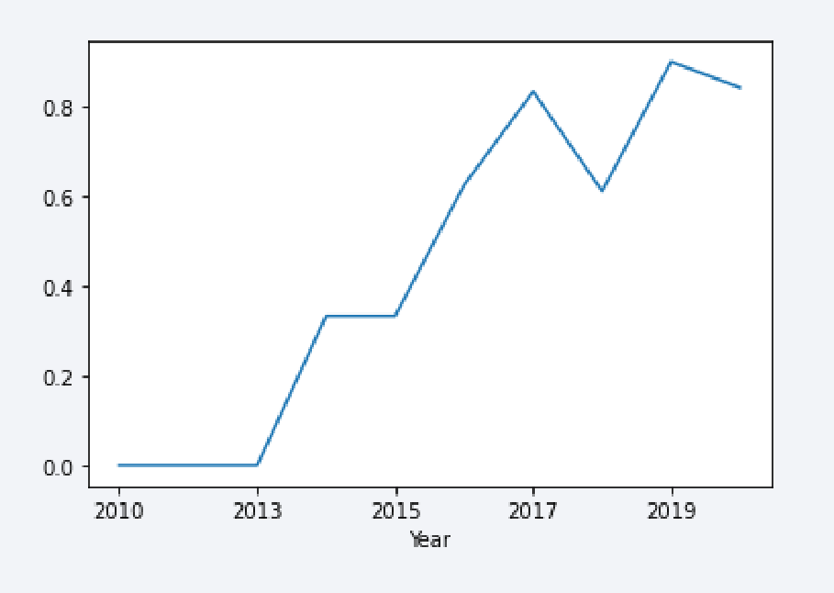
Launch Success Yearly Trend

Slide 25
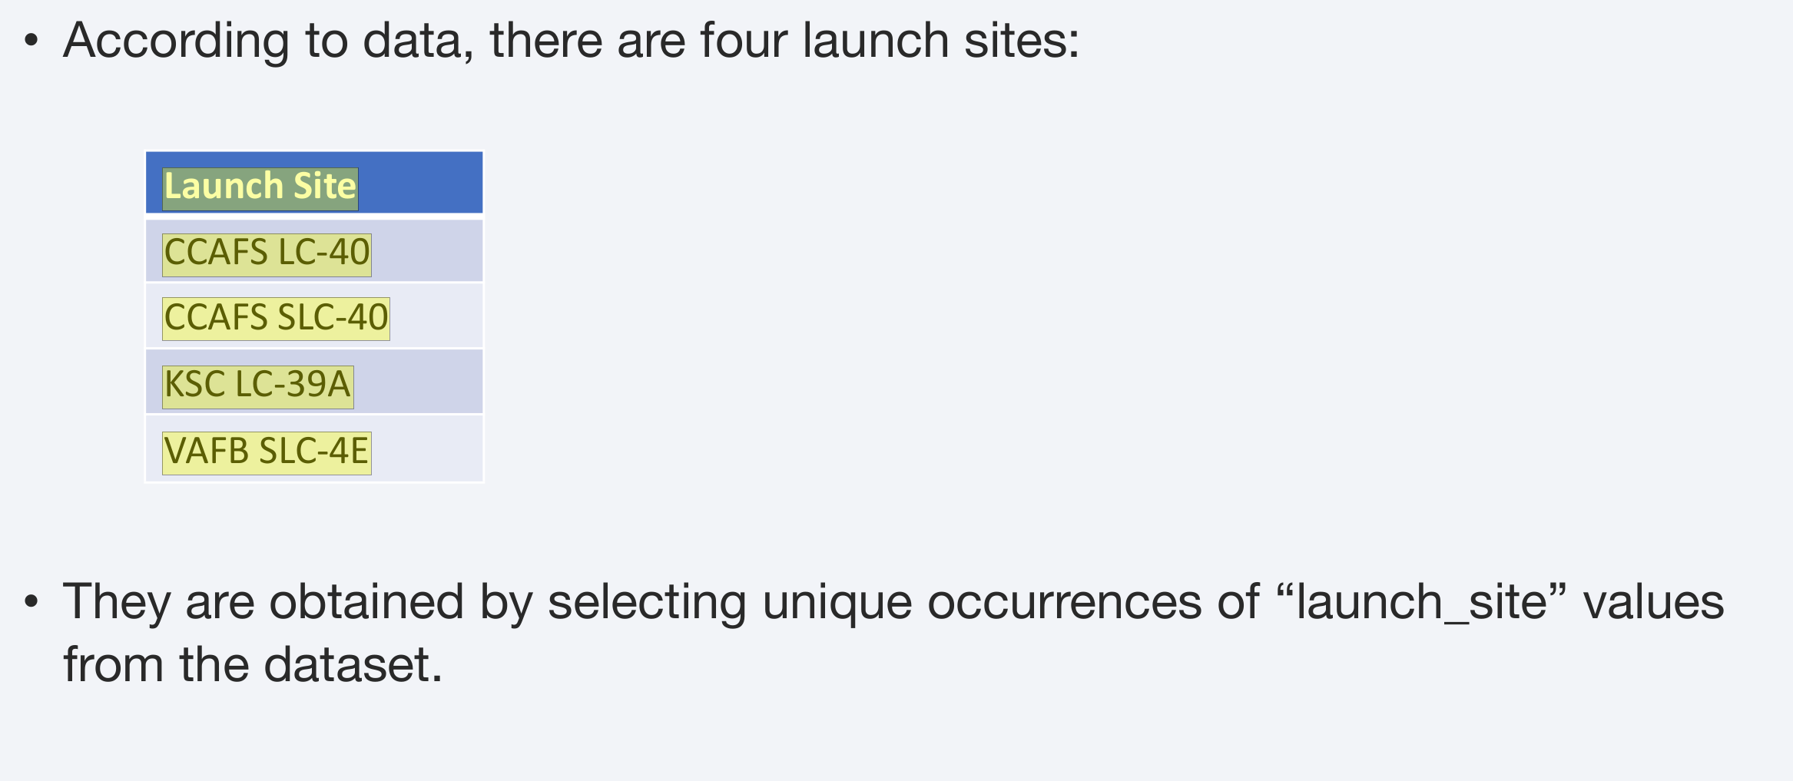
All Launch Site Names
Find the names of the unique launch sites
Present your query result with a short explanation here

Slide 26
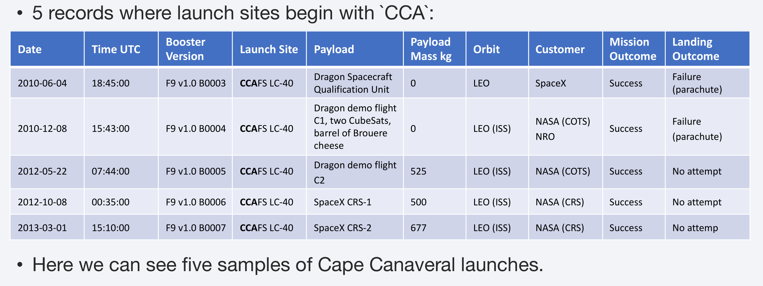
Launch Site Names Begin with 'CCA'
Find 5 records where launch sites begin with `CCA`
Present your query result with a short explanation here

Slide 27
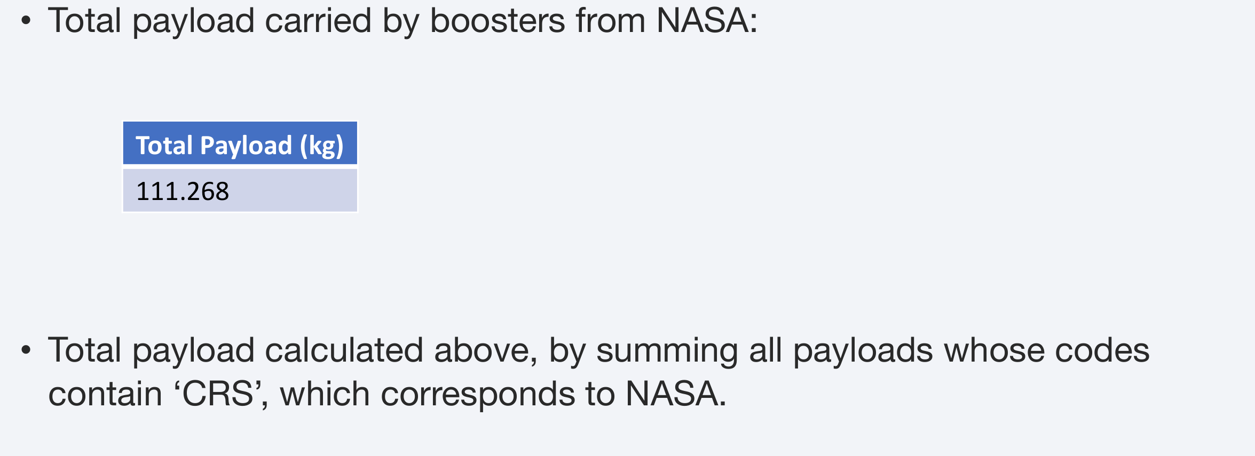
Total Payload Mass
Calculate the total payload carried by boosters from NASA
Present your query result with a short explanation here

Slide 28
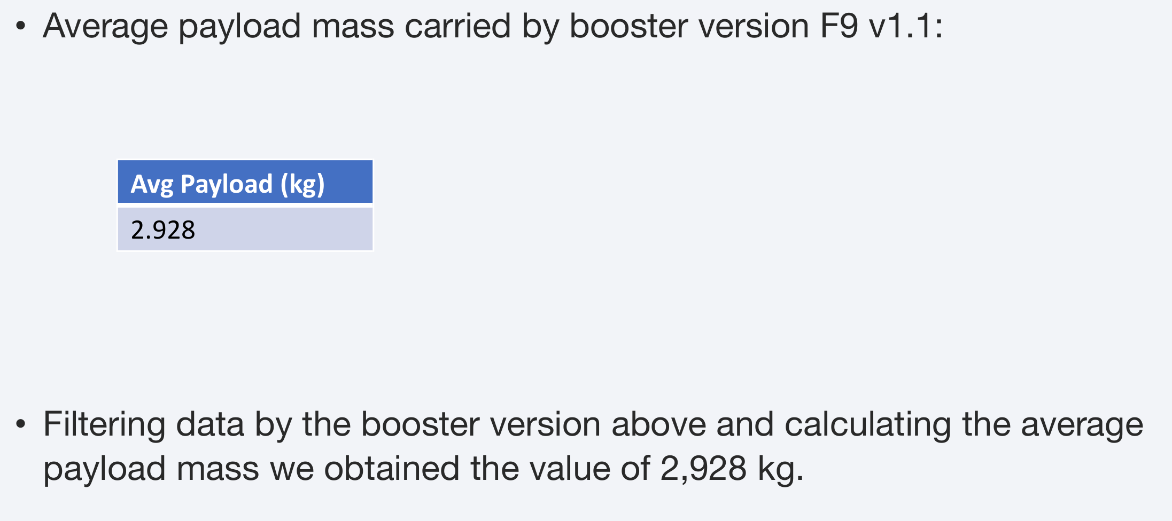
Average Payload Mass by F9 v1.1
Calculate the average payload mass carried by booster version F9 v1.1
Present your query result with a short explanation here

Slide 29
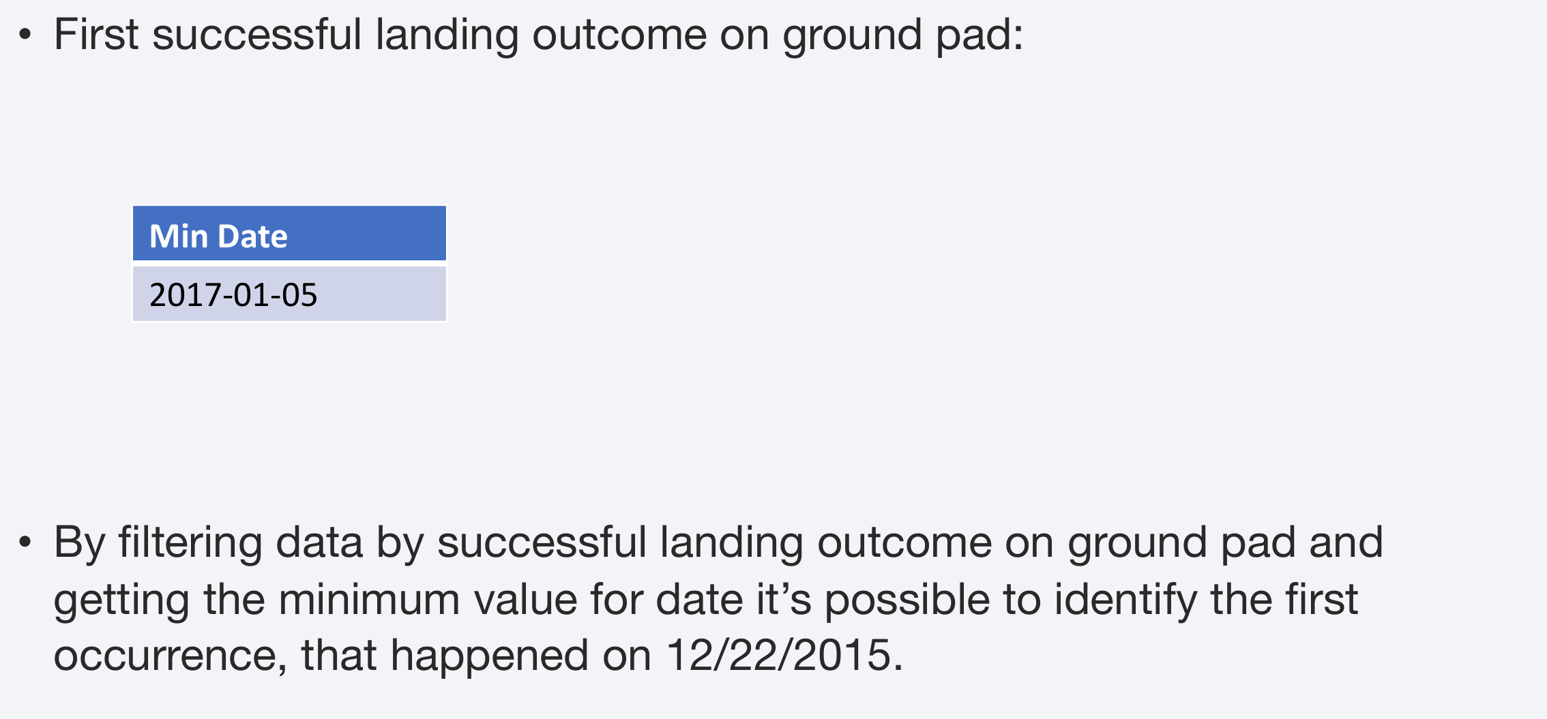
First Successful Ground Landing Date
Find the dates of the first successful landing outcome on ground pad
Present your query result with a short explanation here

Slide 30
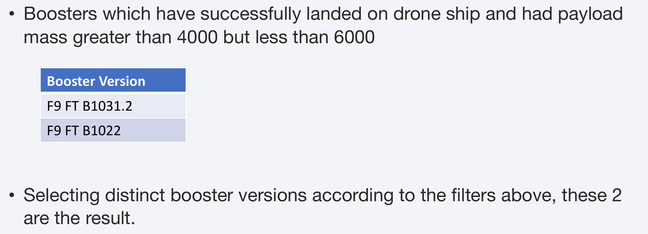
Successful Drone Ship Landing with Payload between 4000 and 6000
List the names of boosters which have successfully landed on drone ship and had payload mass greater than 4000 but less than 6000
Present your query result with a short explanation here

Slide 31
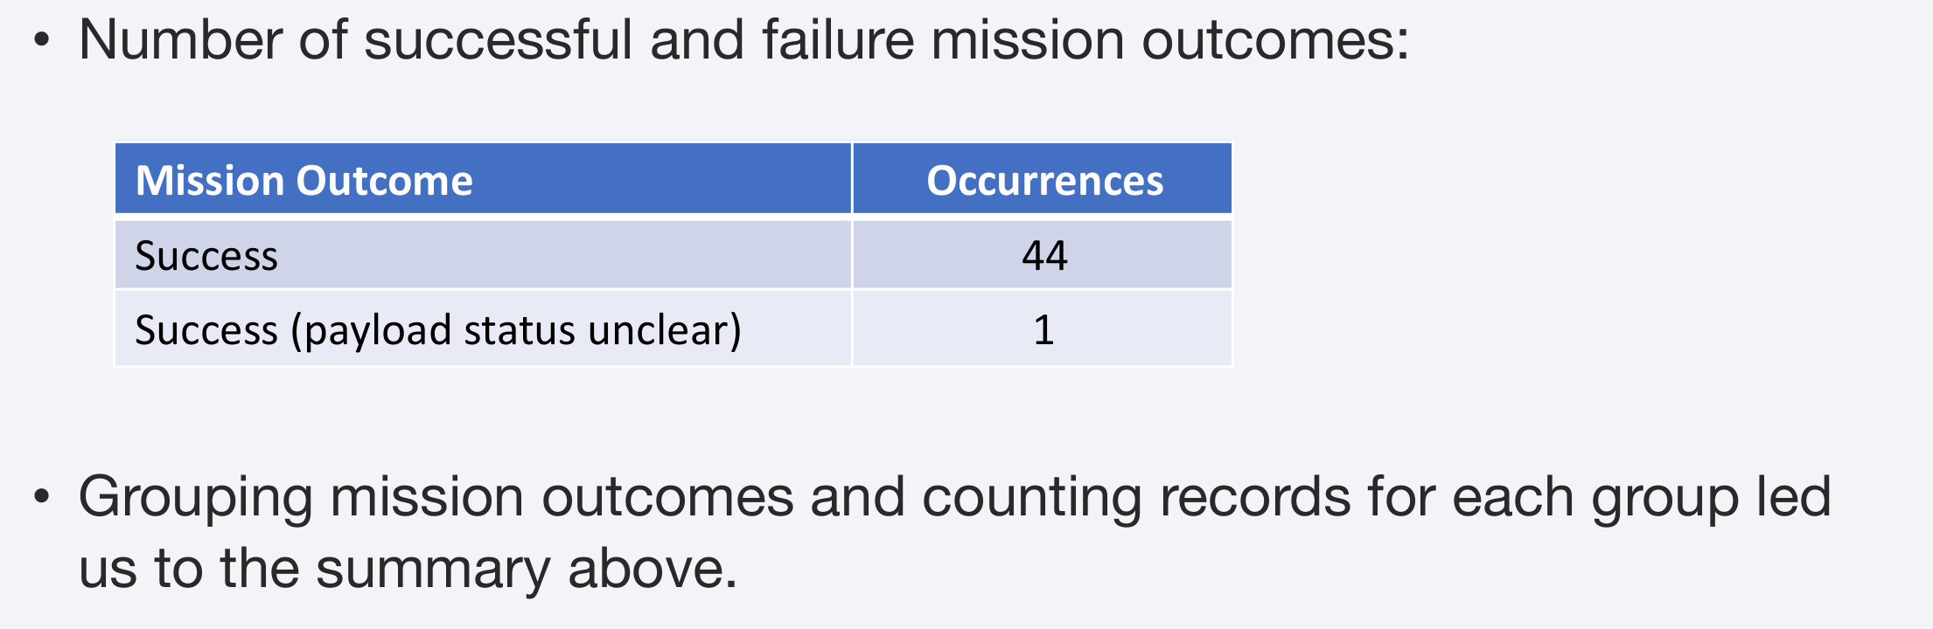
Total Number of Successful and Failure Mission Outcomes
Calculate the total number of successful and failure mission outcomes
Present your query result with a short explanation here

Slide 32
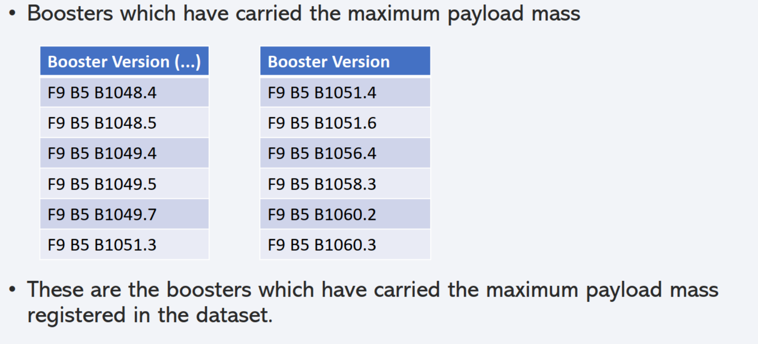
Boosters Carried Maximum Payload

Slide 33
2015 Launch Records
List the failed landing_outcomes in drone ship, their booster versions, and launch site names for in year 2015
Booster Version | Launch Site
F9 v1.1 B1012 | CCAFS LC-40

Slide 34
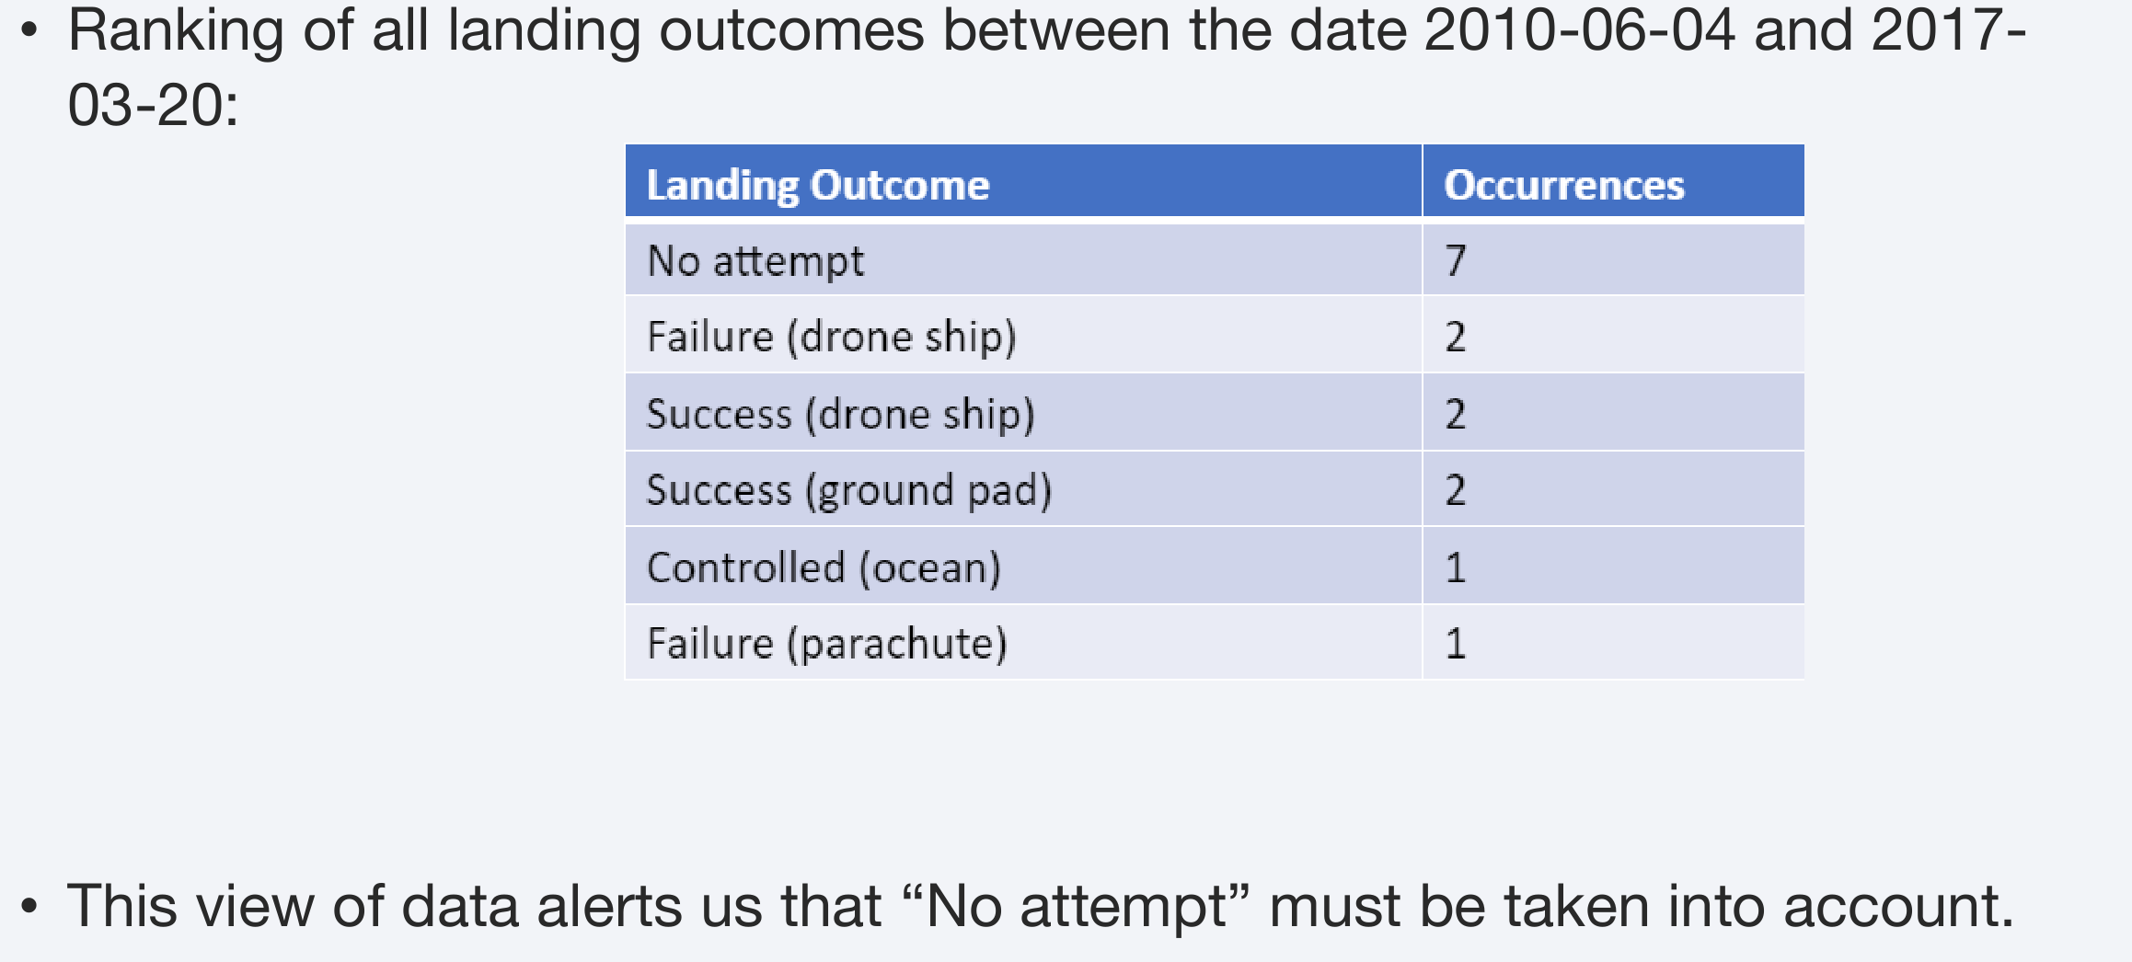
Rank Landing Outcomes Between 2010-06-04 and 2017-03-20
Rank the count of landing outcomes (such as Failure (drone ship) or Success (ground pad)) between the date 2010-06-04 and 2017-03-20, in descending order
Present your query result with a short explanation here

Slide 35

Section 3

Slide 36
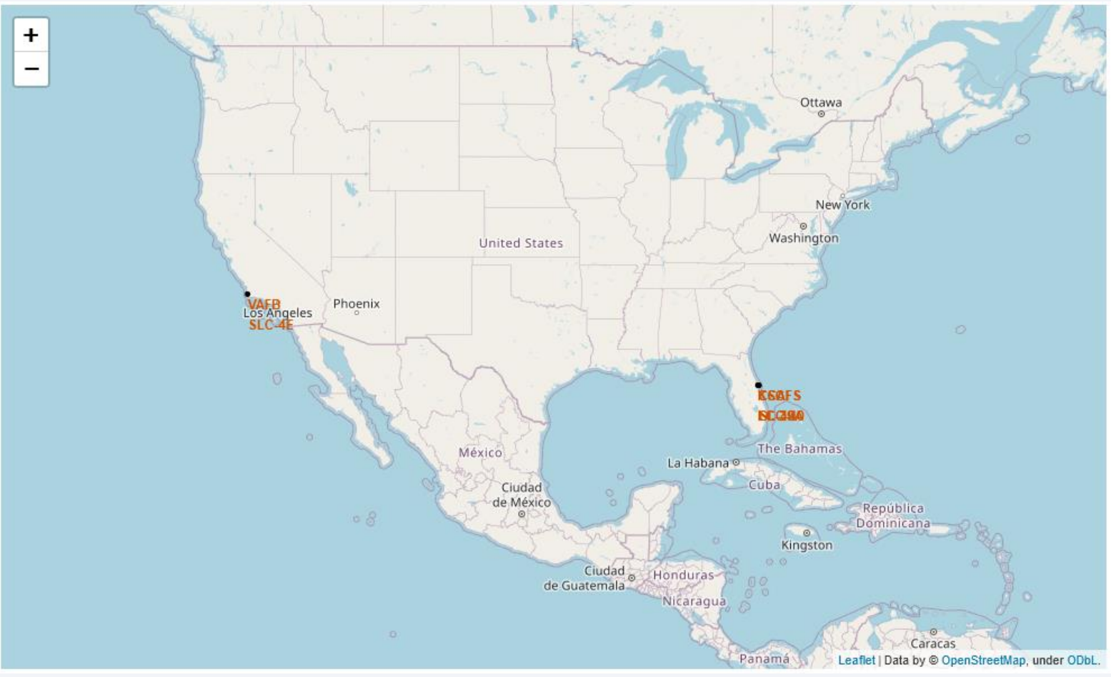
All launch sites

Slide 37
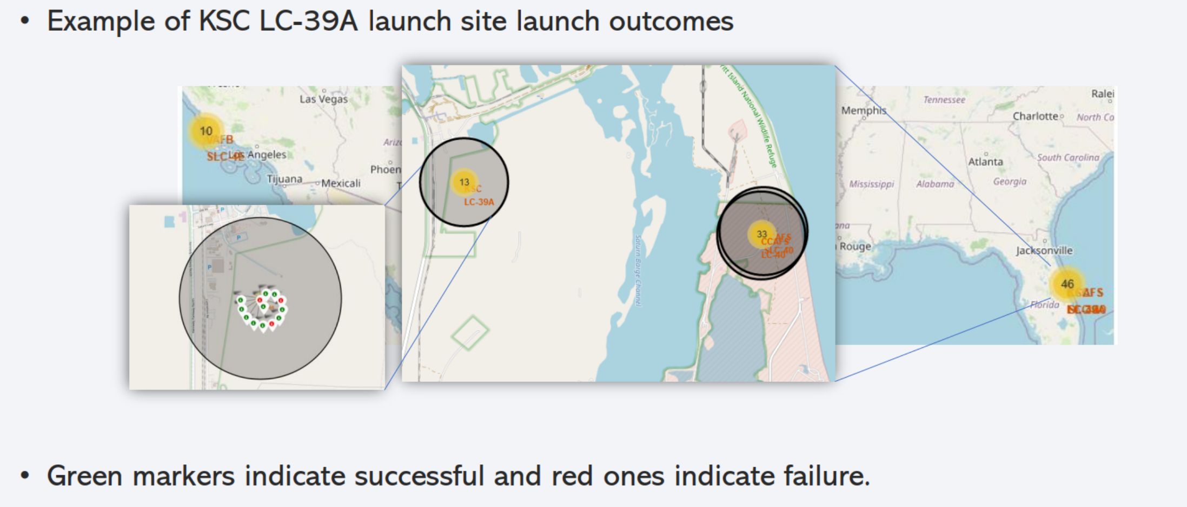
Launch outcome by launch site

Slide 38

Section 4

Slide 39
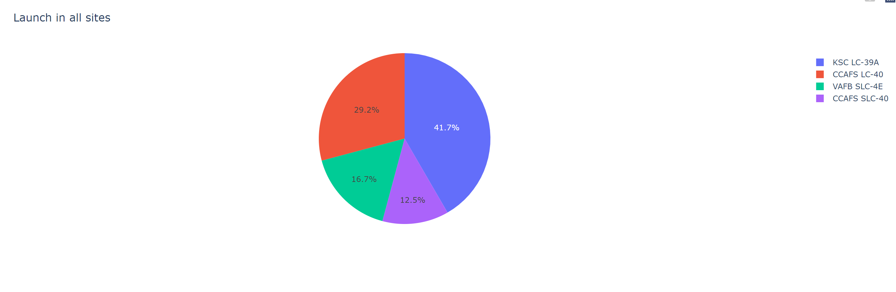
Successful Launches by Site

Slide 40
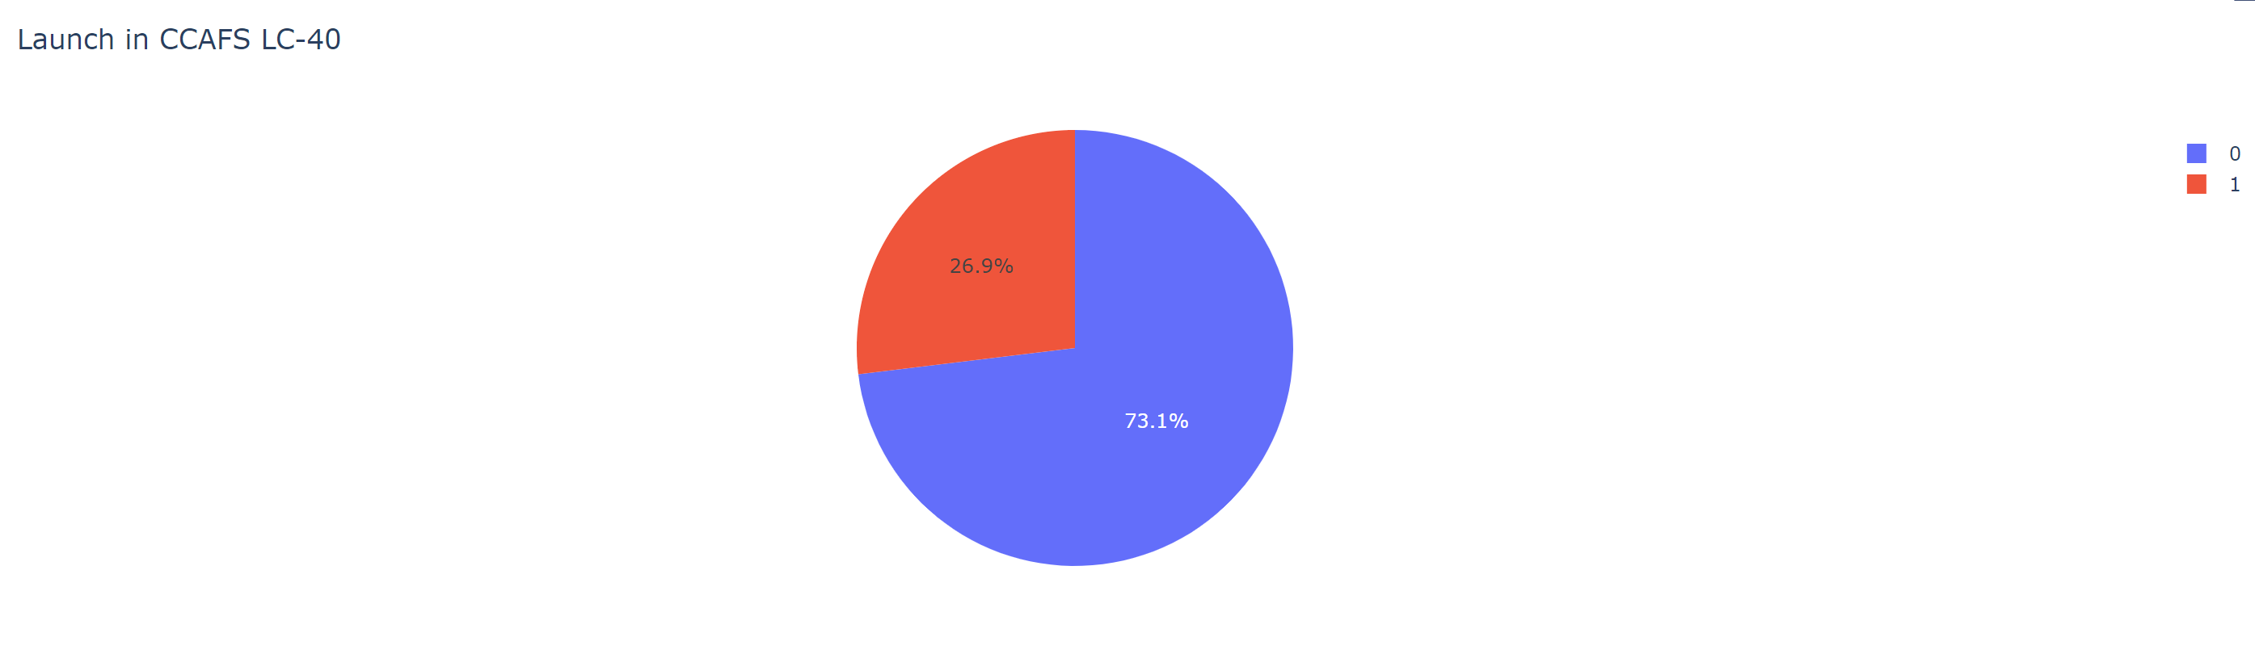
Launch Success Ratio for KSC LC-39A

Slide 41
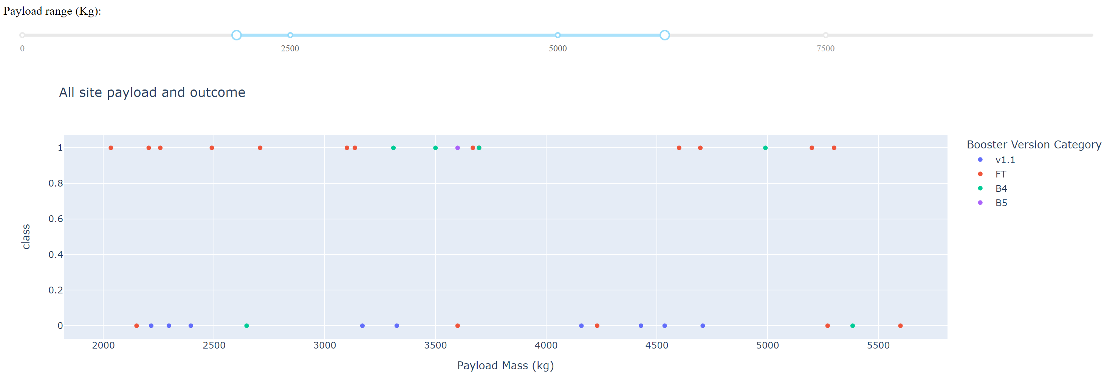
Payload vs Launch Outcome

Slide 42

Section 5

Slide 43
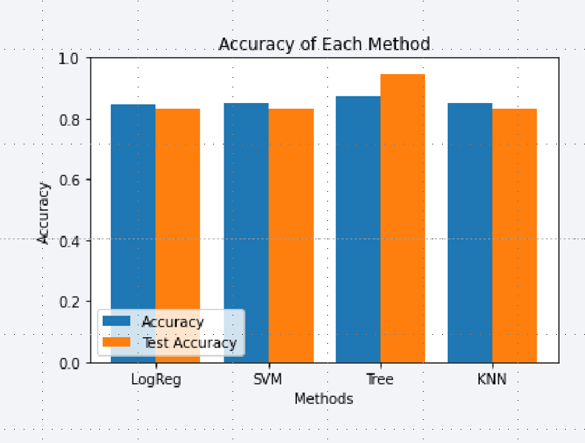
Classification Accuracy
Four classification models were tested, and their accuracies are plotted beside
The classifier model with the highest accuracy is the Decision Tree

Slide 44
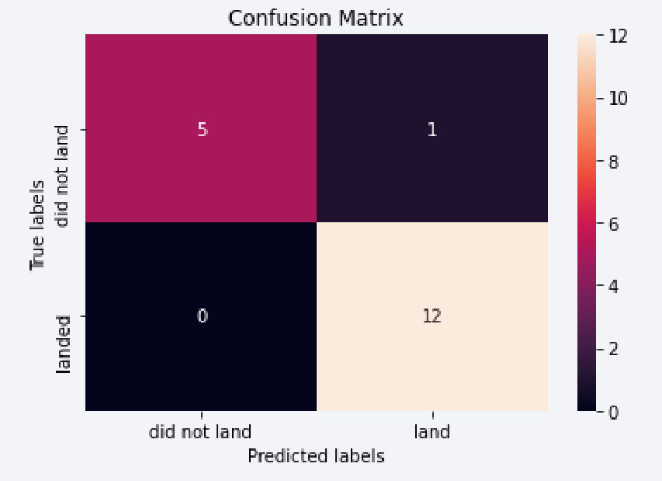
Confusion Matrix
The Decision Tree confusion matrix shows the largest number of true positive and true negative compared to other models.

Slide 45
Conclusions
KSC LC-39A is the launch site with the highest success rate
Higher payload launches are more successful
Decision Tree Classifier can be used to predict successful landings and increase profits.

Slide 46
Appendix
SpaceX API https://api.spacexdata.com

Slide 47


